Slide 1
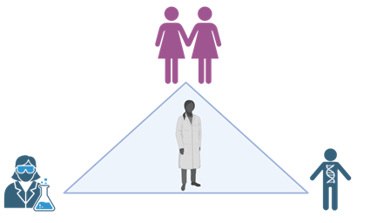
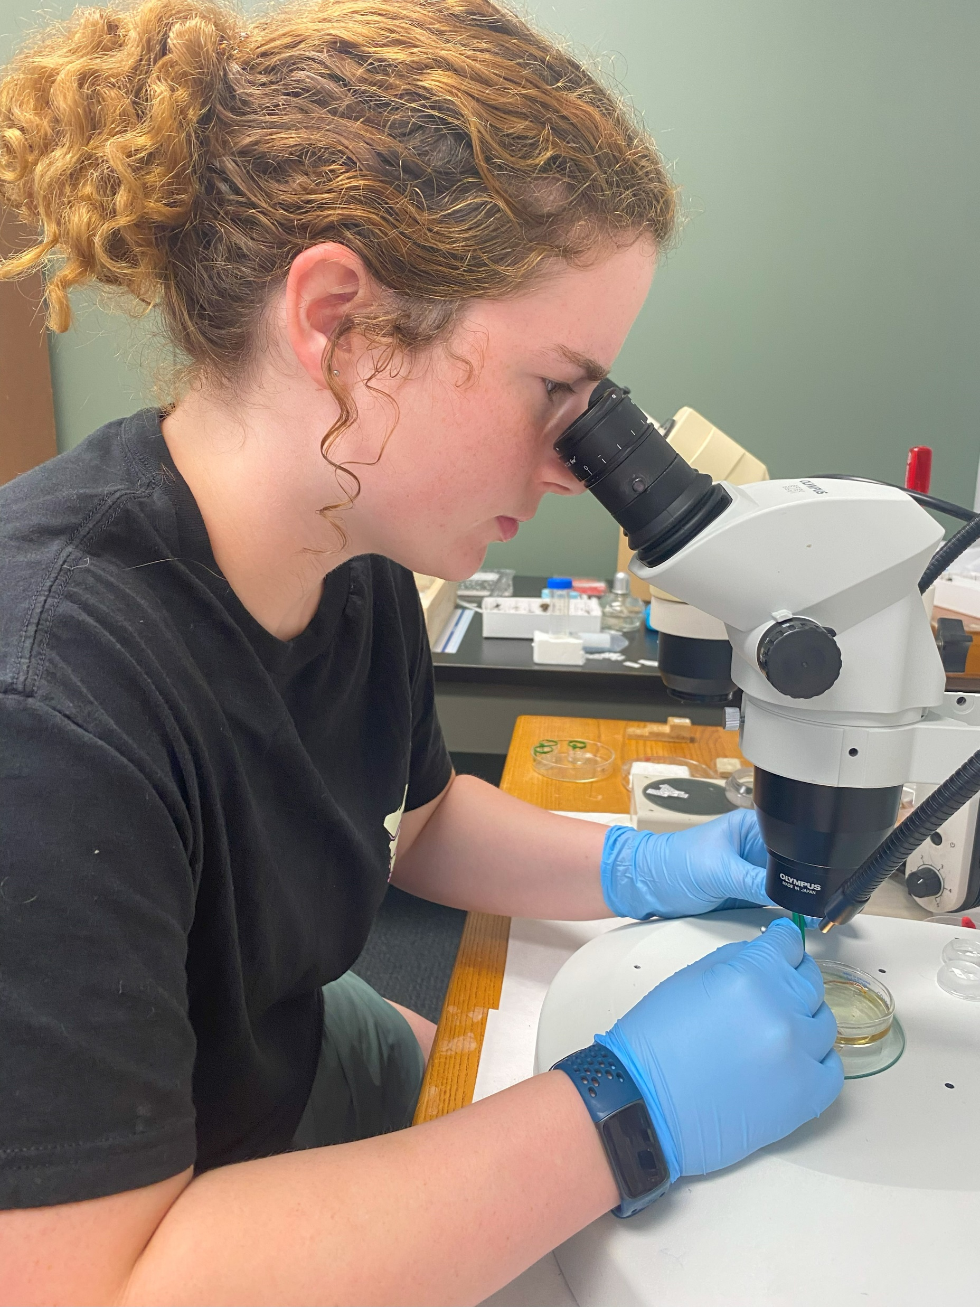
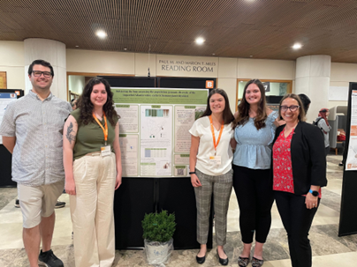
Project Background & Introduction
BiGG FACTS in One Health: Training Next Generation of Women BiGG Scientists
Kimberly D. Gwinn – University of Tennessee
USDA NLGCA Award # TEN2018-05862
Analytical Teams
Microbiome
Population Genomics
Transcriptome
Microbiome
Administration
Content
Evaluation
Graphics created in BioRender
Notes:
Title and content

Slide 2
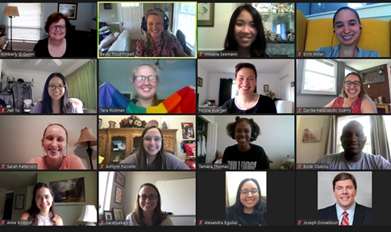
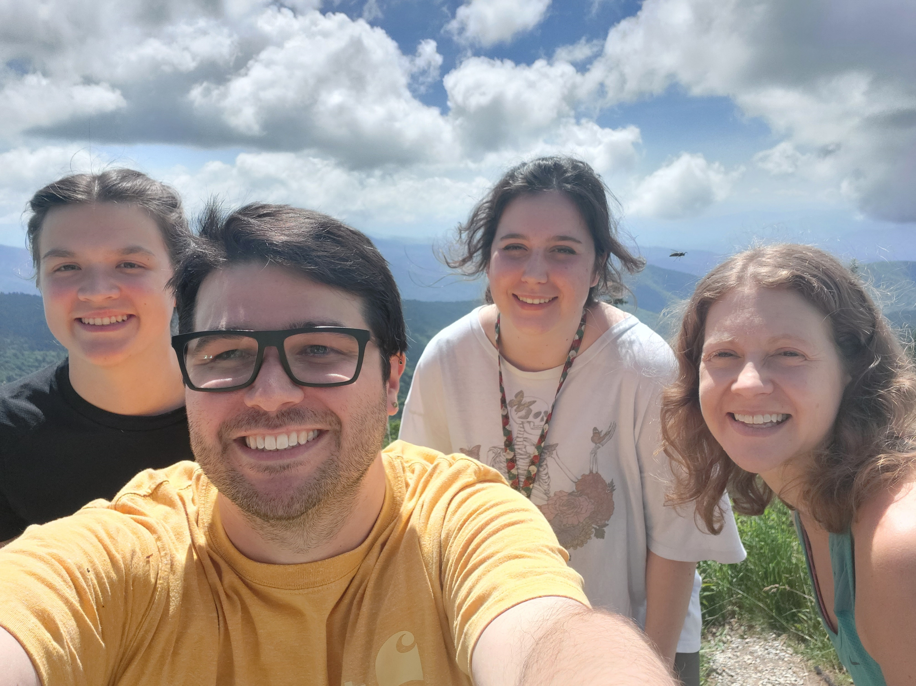
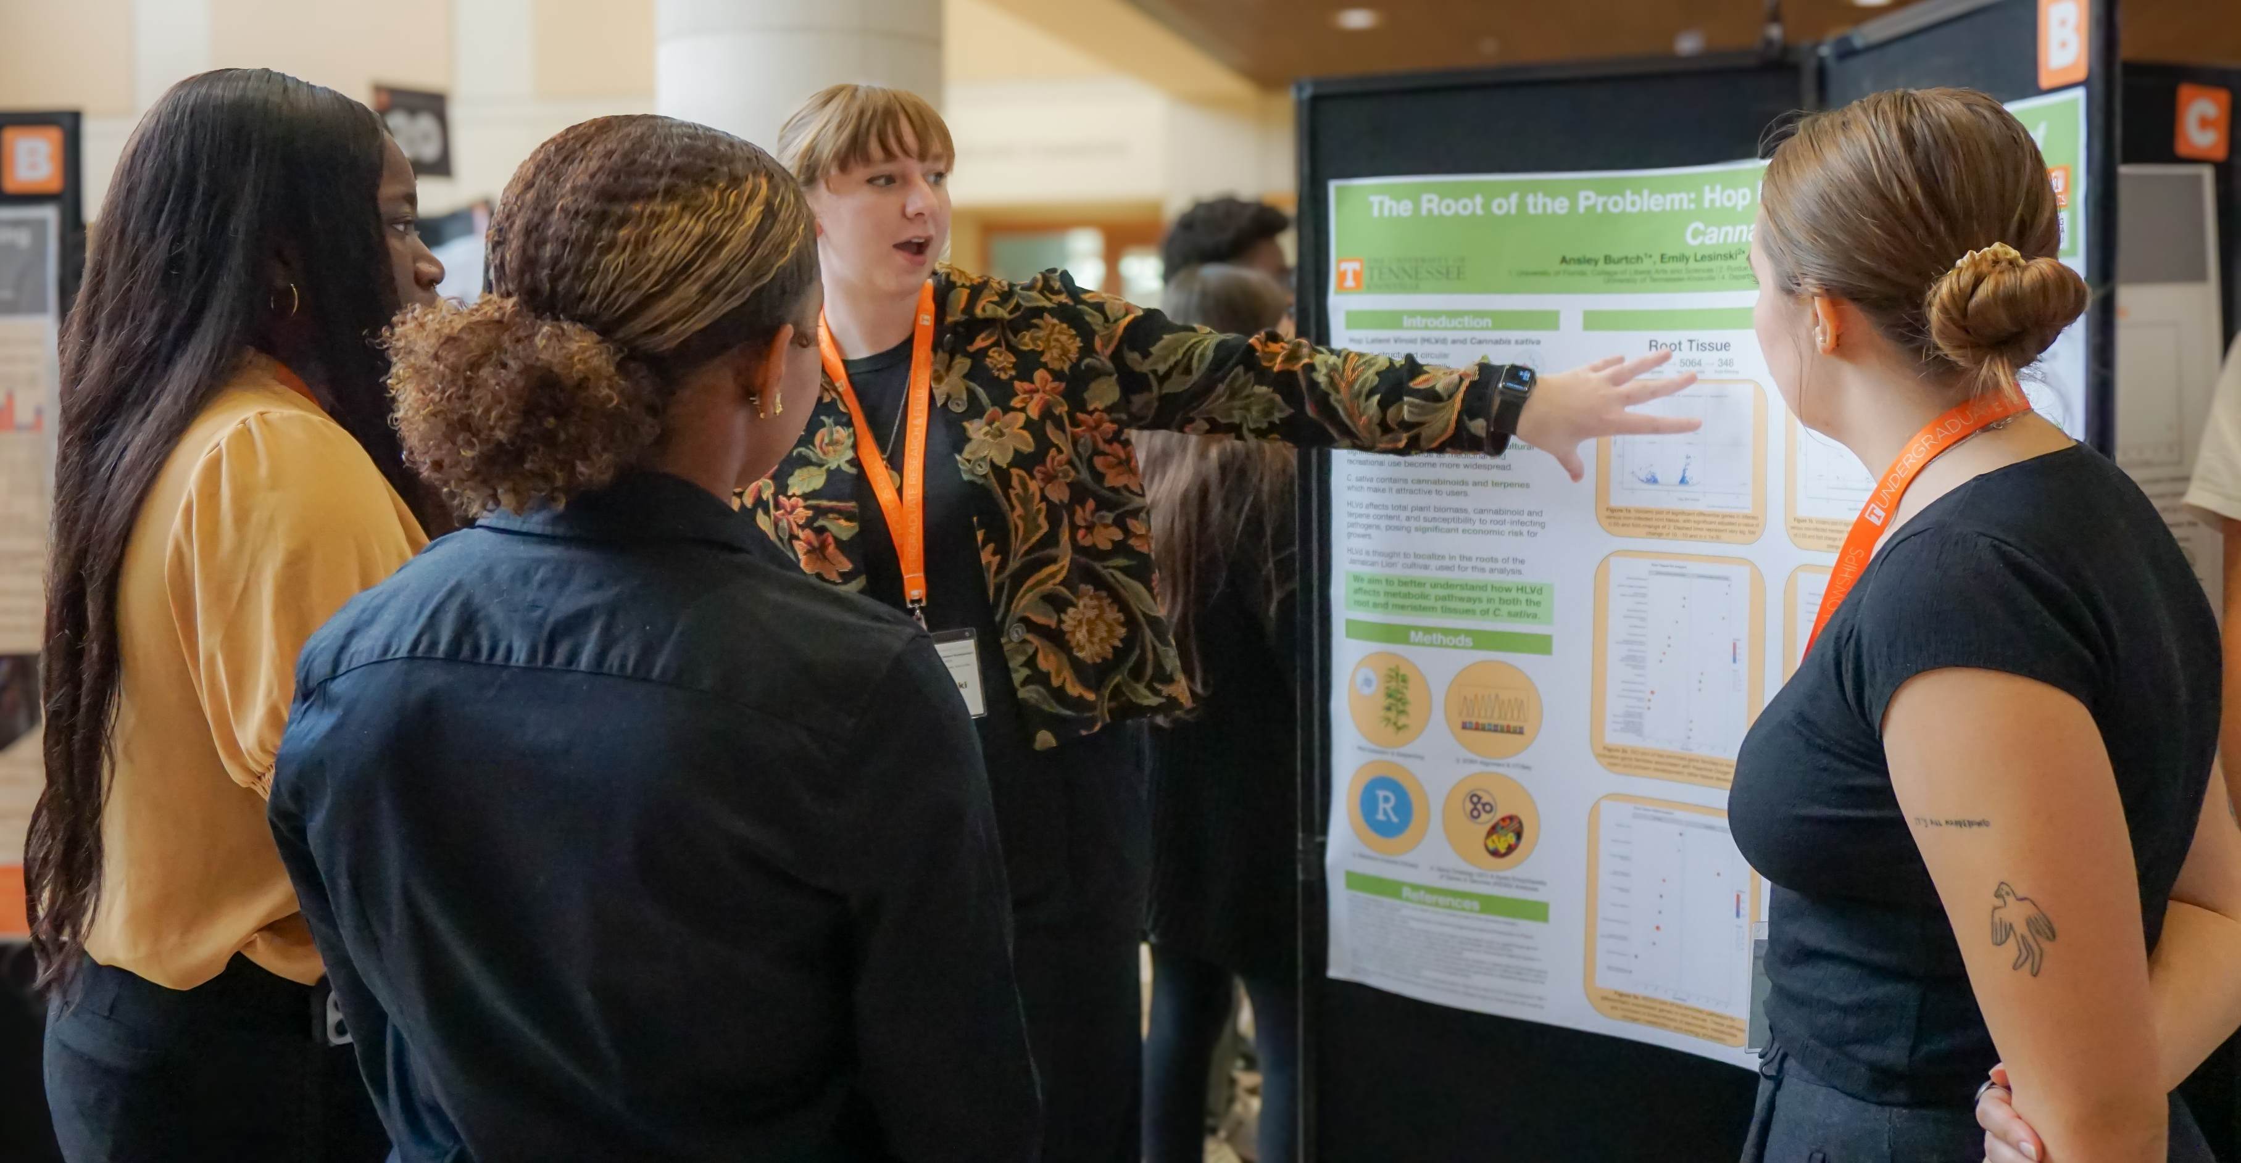
Implementation Challenges & Lessons Learned
Challenges:
COVID
Virtual vs in person
Faculty availability
Onboarding programming
Mentoring skills for graduate students
Lessons Learned:
Lunch-n-Learn
Program Manager
Application Evaluation
Rubric
Interview
Bioinformatics vs Bioinformatics
Summer program >> faculty burnout
Next steps needed
Exit interviews are important
Corporate support
“A lot of us suffer from imposter syndrome as women. We apologize, but I also have found strategies to get around those things [and] have found like a community of women who all believe in me and want the best for me.”
– 2020 BiGG Program Fellow
vs
Notes:
Title and content

Slide 3
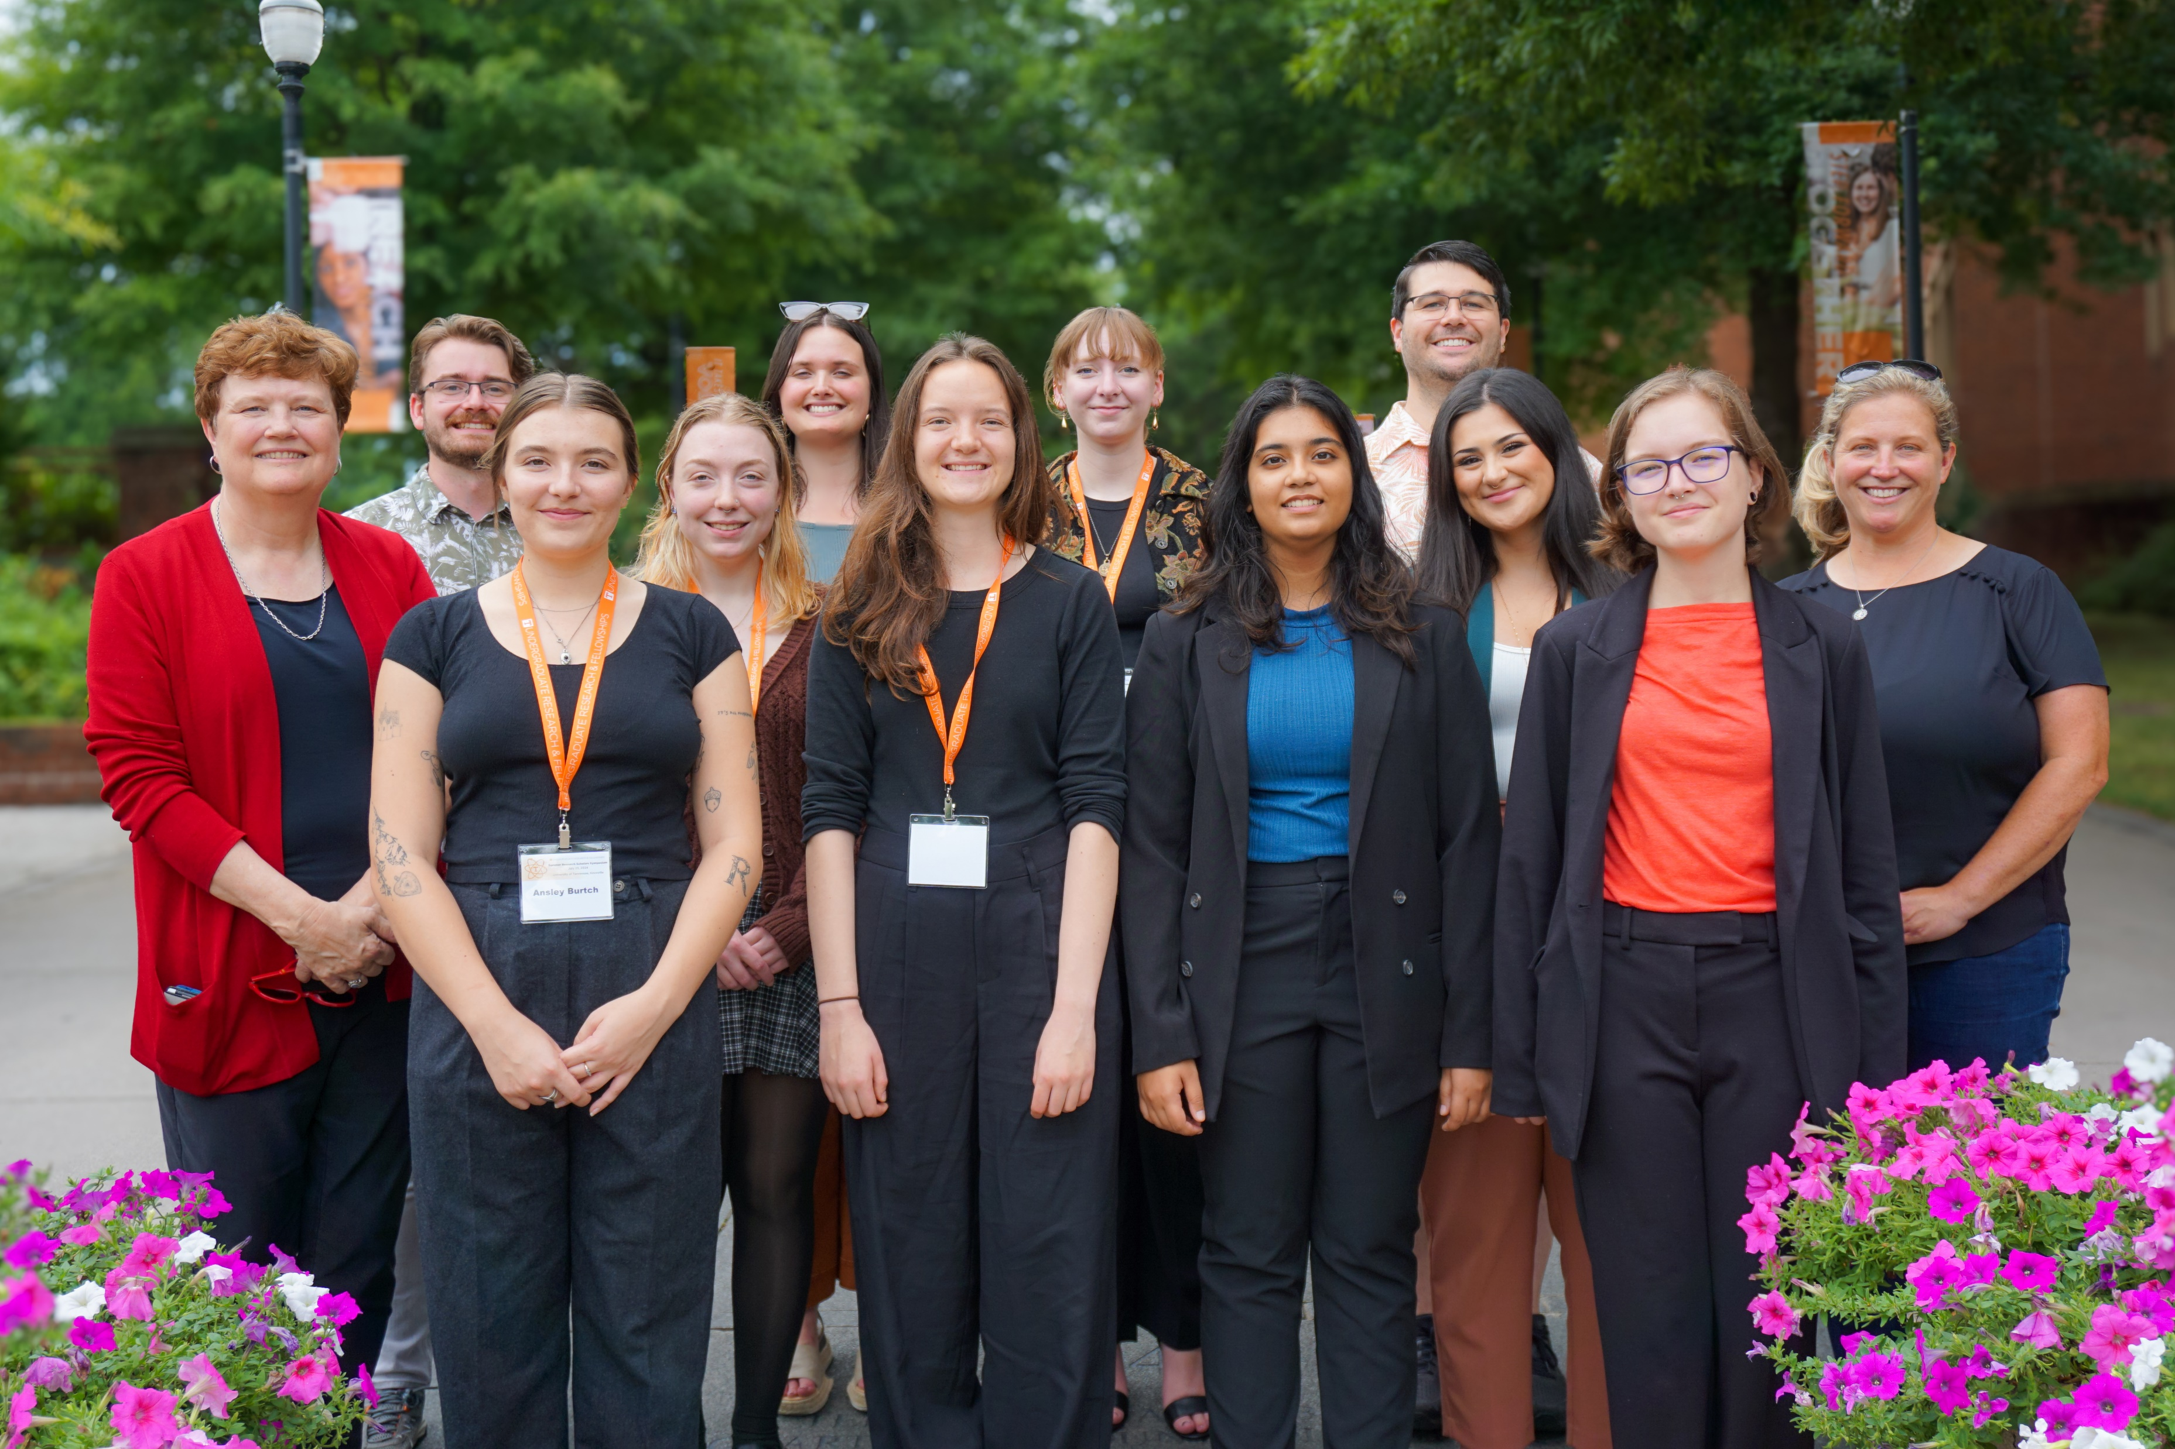
Accomplishments, Impacts & Future Directions
Accomplishments:
Trained students (34 UG; 18 graduate students)
Faculty team building
Onboarding materials
Scientific presentations
Refereed publications
Two bioinformatics papers in print
Ten papers in progress
Impacts:
Increased confidence of women for leadership
Increased application of bioinformatics to agriculture
Change in situation
Graduate school >> pipeline of female bioinformaticians
Graduate student trained as mentors
Future Directions:
Undergraduate major in agricultural bioinformatics
Development of postbaccalaureate programs
Evaluation Summary
Women-led and predominately women research teams are consequential for empowering women students to boost research skills; improve leadership skills; and expand career and academic goals.
Notes:
Title and content

