Slide 1
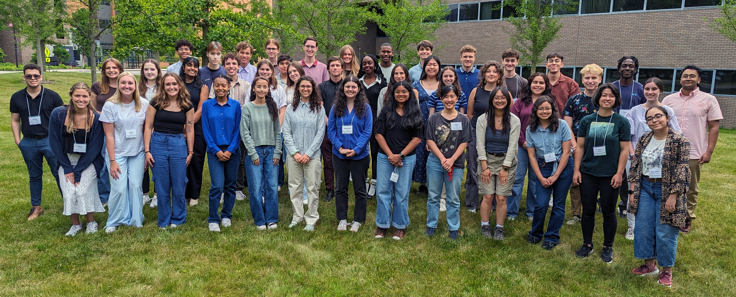
Introduction
Undergraduate Research: Innovative Agricultural Technologies
Georg Jander – Boyce Thompson Institute
Scott McArt – Cornell University
USDA NLGCA Award #2022-67037-3622
There is a need to train future scientists who will develop Innovative Agricultural Technologies and improve agricultural productivity.
Program Goals
Recruit a diverse cohort of students from throughout the United States
Provide plant molecular biology research training
Prepare students for graduate school
Engage local communities with plant molecular biology outreach activities
Notes:
Title and content

Slide 2
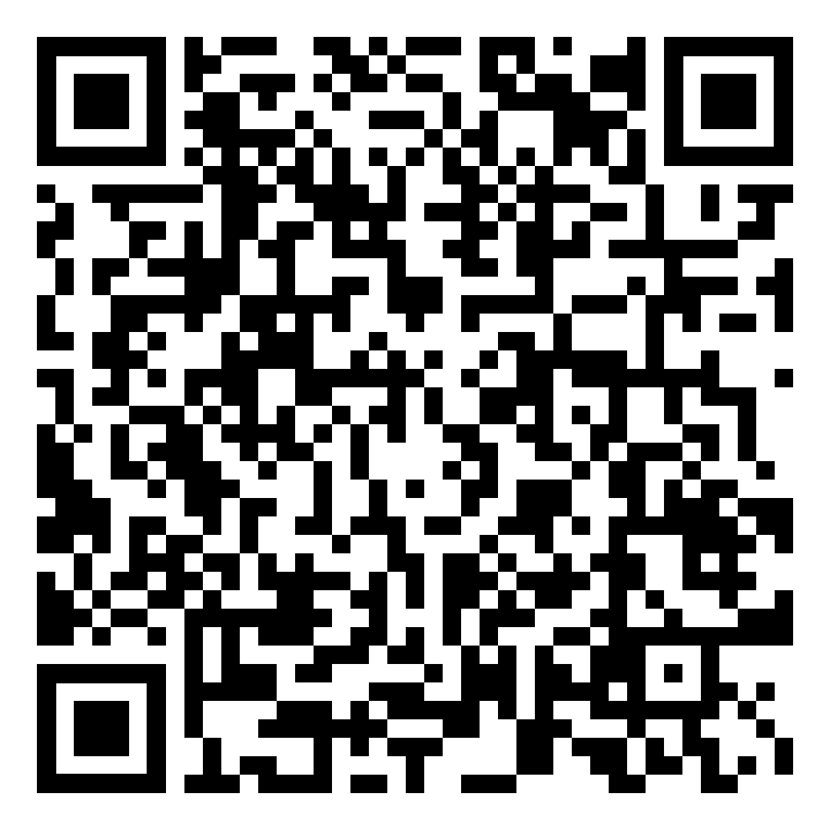
Implementation Challenges & Lessons Learned
Challenges:
Student recruitment
Mentor/mentee expectations
Lessons Learned:
Rolling admissions – get students to commit as early as possible
The NSF ETAP system for REU applications is great
Mentor training is important
Students are contacted by their research mentors prior to arrival
Mentor/mentee agreement is read and signed by both
Non-performing mentors are not invited back
mentor/mentee
agreement
Notes:
Title and content

Slide 3
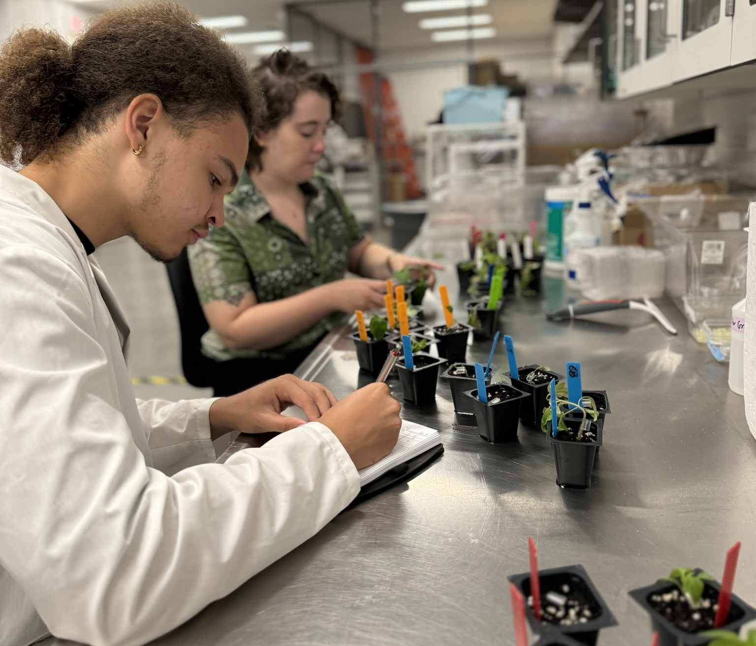
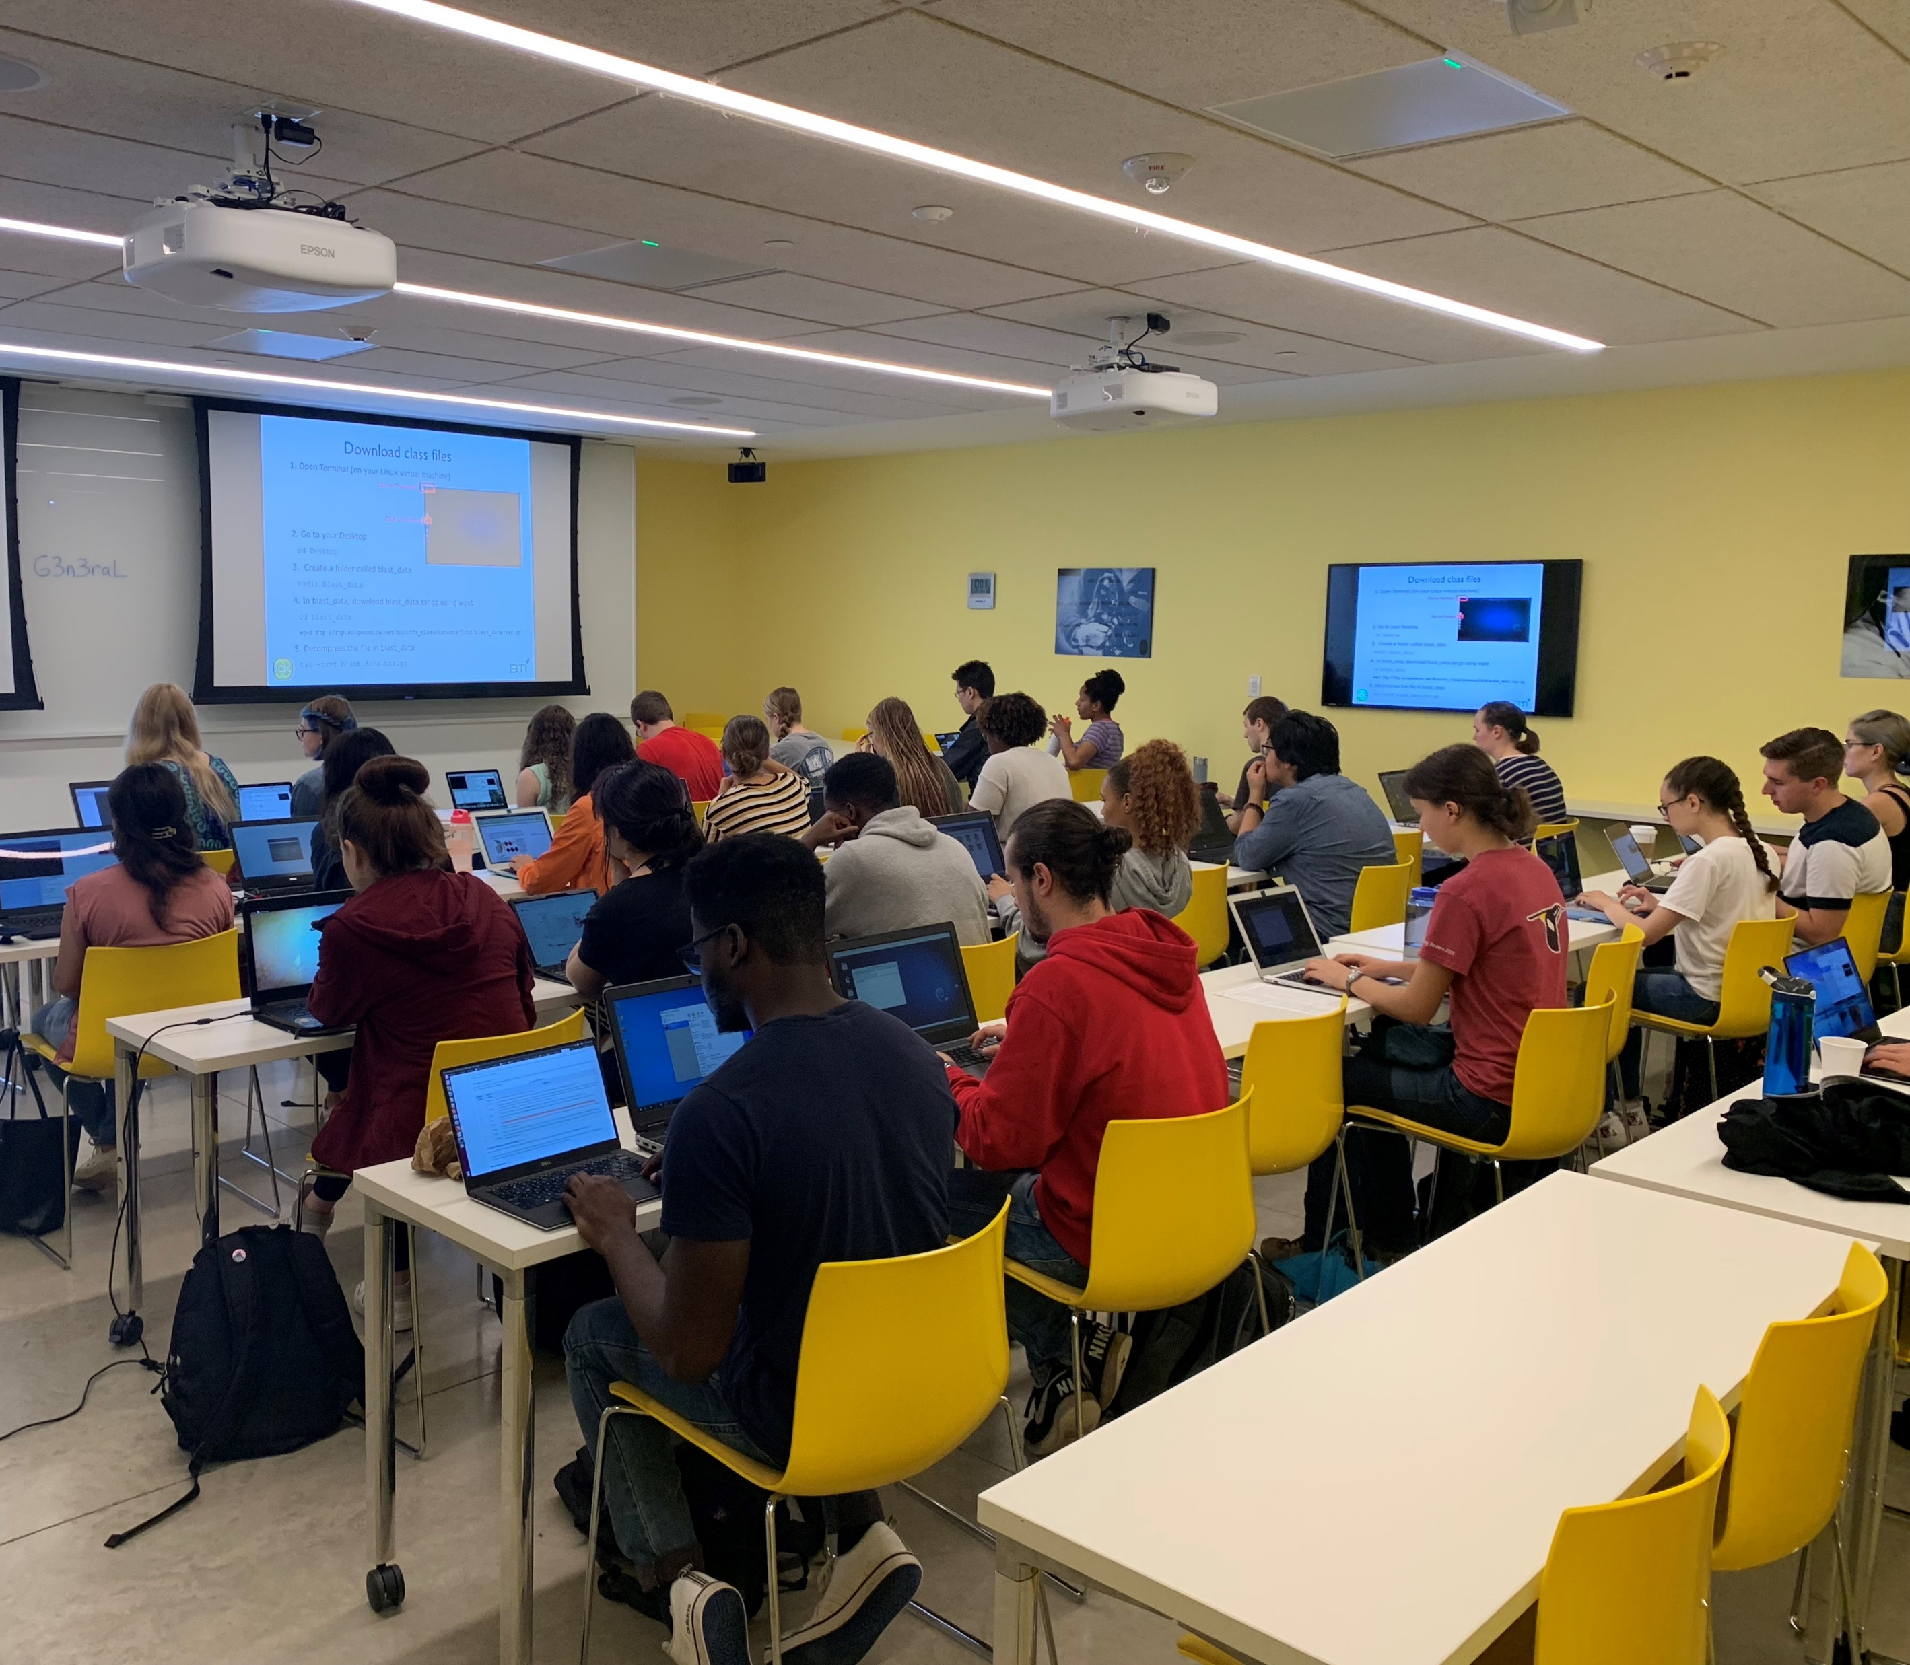
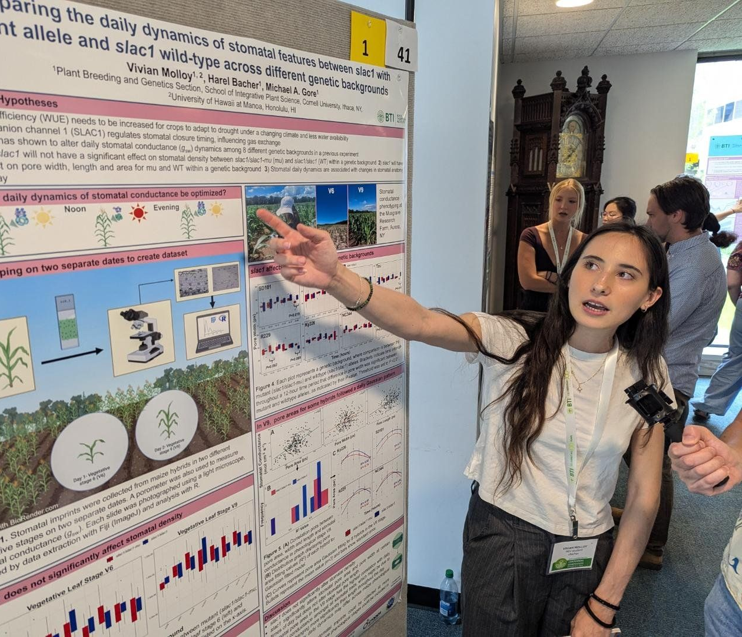
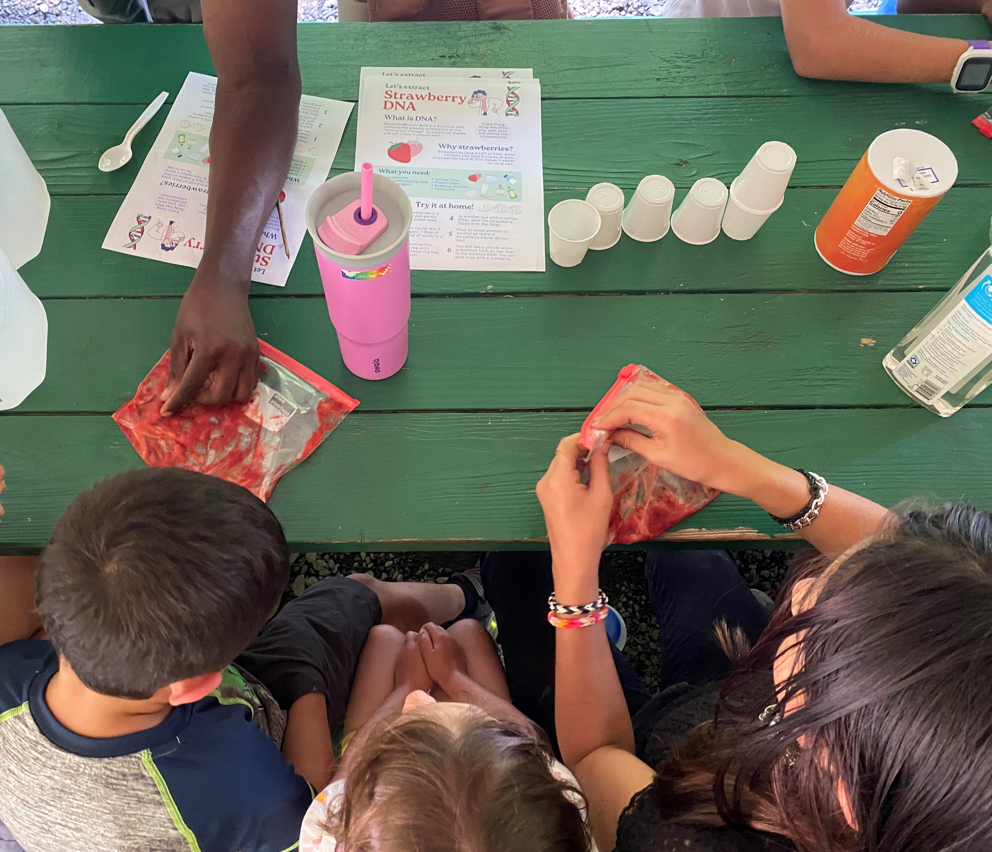
Accomplishments, Impacts & Future Directions
Accomplishments:
Student
Research
Bioinformatics
Training
Graduate School
Information Sessions
Research
Presentations
Outreach
Activities
Impacts:
36 students received training through the current REEU award
>70% of past participants go to graduate school in a STEM field
Future Directions:
Track student activities – publications, graduate school, careers
Assist with applications and presentation of research results
Notes:
Title and content

