Slide 1
Project Background & Introduction
Research Fellowships to Prepare Diverse Students for Careers in FANrHs
Wanda Crannell and Dr. Susan Rowe, Oregon State University
USDA Award # 2020-67037-30670
Project goals
Engage 30 underserved/marginalized students in research to provide them with skills to enter the agricultural workforce or pursue graduate studies
Improve representation of underrepresented students in STEM, agricultural and environmental fields
Initial program structure
Recruitment: 6 students/year; 50% community colleges/CAMP*/SMILE^ and 50% OSU students
Duration: 10-week summer sessions that includes an 8-week research project
Other resources: Faculty and peer mentors, community engagement opportunities, and professional development
*College Assistance Migrant Program ^Science and Math Investigative Learning Experience
Notes:
Title and content

Slide 2
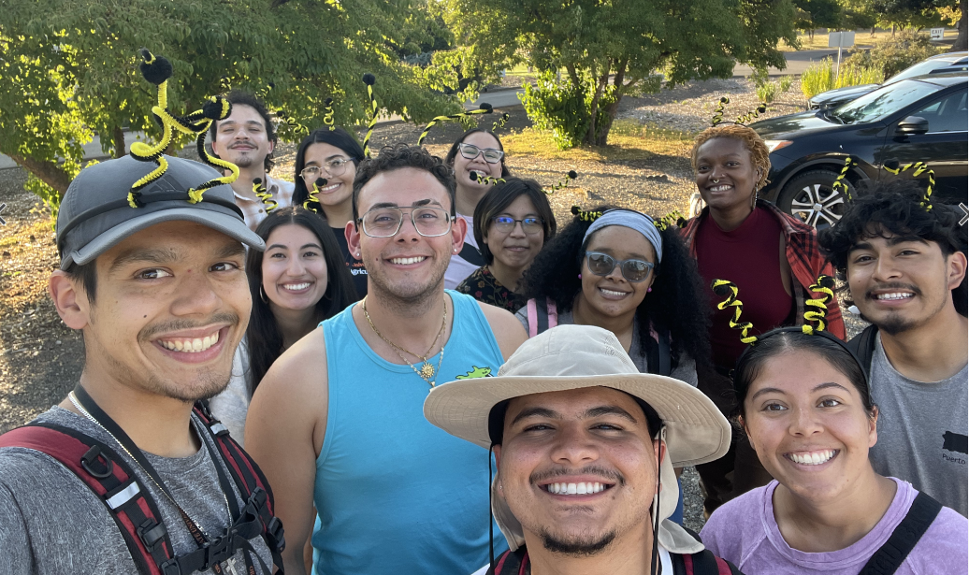
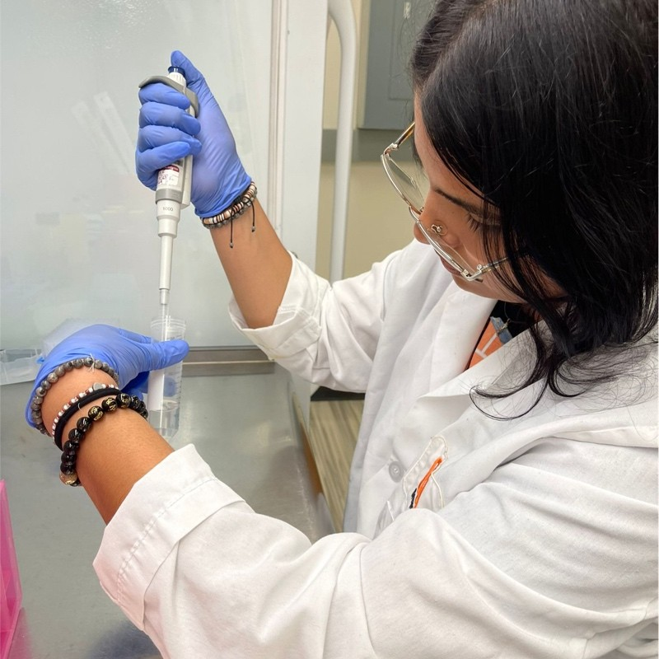
Implementation Challenges & Lessons Learned
Student recruitment during pandemic (Summer 2020 & 2021)
Pivot: funded current undergraduate research students, BES, online mentoring of Jr MANRRS (high school) students, virtual MANRRS conference
Inflation impacts on stipend - $4800 no longer competitive (2022-23)
Pivot: research embedded into academic year with larger cohort of students
Finding most effective cohort size
2020: 7 OSU students (virtual)
2021: 7 OSU students (hybrid)
2022-23 AY: 8 peer mentors (experienced students) and 11 new mentees (DPP*)
2024: 6 OSU students (recruited from service-learning trip) and 6 students from Puerto Rico 12
Pictures from the 2024 summer REEU cohort
*Degree Partnership Program (dual enrollment at OSU and community college)
Notes:
Title and content

Slide 3
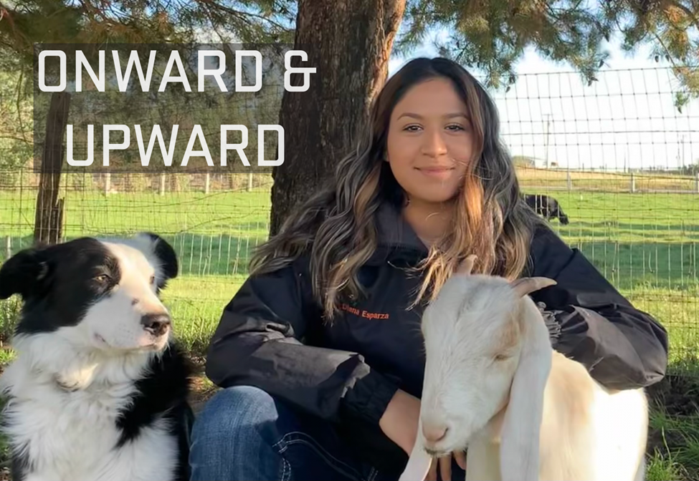
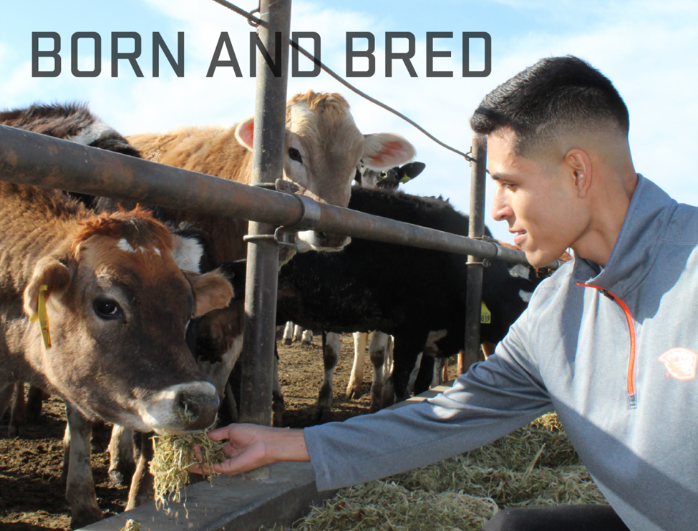
Accomplishments & Outcomes
Water allocation and scheduling for blueberries in Florida using evapotranspiration-based irrigation
Socioeconomic status and parental knowledge on children's exposure to flame retardant chemicals
Take care of yourself: surveying soil, people, and food sovereignty
Flax to linen: Exploring rapid screening methods for fiber quantity in flax
Oregon double up food bucks nutrition incentive program statewide evaluation
Quantifying nutrient transport in Western Oregon soil after the addition of dairy manure
Stream-aquifer interactions along an Oak Creek reach near Corvallis, OR
Diversity of Fusarium Species associated with Fusarium Canker of Hop
Identifying nitrogen fixing bacteria in Kombucha
An investigation into microplastics, PCBS and mercury bioaccumulation in Pacific Lamprey of the Columbia River Basin
Opportunities and limitations in achieving real-time observations of soil nitrate
Addressing food deserts with common gardens: a literary review on sustainability
Eat whole grains but first, learn how to process naked barley
Transcriptome analysis shows promise as first step in eliminating genetic engineering bottlenecks in poplar
Abundance and diversity of macroinvertebrates as indicators of agriculture channel health
Developing a simple sequence repeat (SSR) Fingerprinting Set to characterize the USDA Currant and Gooseberry collections
Exploring the growth habits of sweetpotatoes (Ipomoea batatas) in the Willamette Valley of Western Or.
Understanding the prevalence and abundance of urban agriculture
Impact of additives in the chemical recycling of plastic waste using heterogeneous tandem dehydrogenation and olefin metathesis
Assessing the Prevalence of Per- and Polyfluoroalkyl Substances (PFAS) in Bottled Water
Impact of Hanseniaspora uvarum Yeast from Oregon on Wine Quality
Developing a dynamic in vitro digestion model for SHIME that simulates digestion of preterm infants
Anthopleura elegantissima – Behaviors of Competition in Intertidal Anemones of the Oregon Coast
Hyperspectral Imaging System for Evaluating Seed Moisture Content in Perennial Ryegrass
Evaluating spoilage potential of Brettanomyces isolates from Oregon
Effect of Pulsed Electric Field on Indaziflam Degradation from Soil: Methods Validation
Soil Physical Properties in a Riparian Pasture and Traditional Pasture in the Willamette Valley, Oregon
Supporting Diversity in STEM through Art: Returning the “A” to STEM Through Art Therapy
Exploring Methods for Breaking Seed Dormancy in an Oregon Native Plant, Mentzelia, mollis
Anthopleura elegantissima – Behaviors of Competition in Intertidal Anemones of the Oregon Coast
Innovative Grazing Strategies: Managing Riparian Areas and Invasive Species
Ovarian protein hormones as biomarkers of fertility in dairy cows – Is it an acceptable model to predict infertility in dairy breeds?
Onion Thrips Resistance Monitoring to Insecticides Reaper and Lannate in the Treasure Valley
Using a Simple Sequence Repeat (SSR) Fingerprinting Set to Characterize the USDA Ribes Collection
Dairy cow forage nutritional analyses on urine, feces and milk samples
Invest in Vegetables: A Cost and Benefit Analysis of Container Grown Roma Tomatoes (Solanum lycopersicum cv. ‘Roma’) and Italian Basil (Ocimum basilicum cv. ‘Italian’)
Monitoring resistance in onion thrips to insecticides, Lannate and Exirel in the Treasure Valley of Eastern Oregon
Comparison of Ammonia Inhibition on the Anaerobic Digestion of Organic Acids Between Digestate from Anaerobic Co- and Mono-Digestion Systems
Effects of Selenium Supplementation During Different Trimesters of Pregnancy on Natural IgM Antibody Concentrations in Beef Cows at Parturition
Endometrial Inflammatory Cytokine Expression in Postpartum Beef Heifers Following Platelet Rich Plasma Treatment
Effects of selenium supplementation during different trimesters of pregnancy on non-specific humoral immunity of pregnant beef cows and persistence of antibodies in their newborn calves
A Needs Assessment of Social Emotional Learning Integration in Pre-College STEM Education at OSU
Guinea pig model of mild hyperandrogenemia – is it a suitable model for women with polycystic ovary syndrome (PCOS)? A pilot study
Collecting and analyzing data for Brown Marmorated Stink Bug (BMSB), Spotted Wing Drosophila, Filbert Worm, and Aphids
45 research projects (see titles scrolling on right)
7 colleges, 13 departments, 2 expt. stations, 3 USDA ARS & NCGR
41 students - 4 served 2nd year as program assistants
37% CAMP students
Graduation & retention statistics - 97.5%
22 graduated; one stopped out
10 entered graduate/prof. school
Notes:
Title and content

