Slide 1
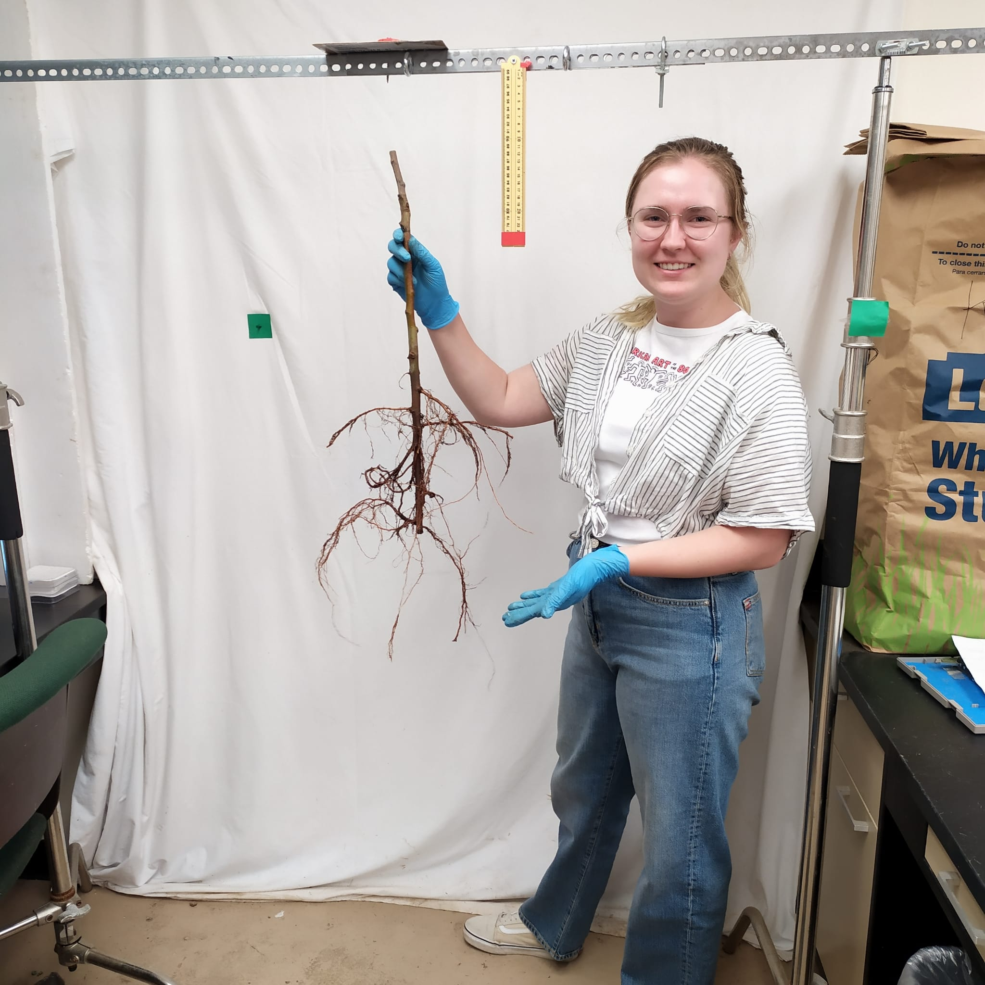
Project Background & Introduction
TITLE: Cornell AgriTech FACT REEU: Enhancing the Digital Agriculture Workforce Pipeline
Kyle Wickings – Cornell AgriTech, Cornell University
Award * - 2021-68018-34652
9-week hands-on program
Specialty-crop-focused research projects
Entomology, Plant Pathology, Horticulture, Food Science and Agribusiness
Professional development programming
commodity-themed field trips to meet producers and extension specialists
topical discussions
science/extension communication
agricultural careers in academia and industry
graduate admissions processes
digital technologies in agriculture
Notes:
Title and content

Slide 2
Implementation Challenges & Lessons Learned
Challenges
Lessons Learned
Average increase in REU stipends
Housing and Transportation
Administrative program support
Program length
What would you do differently?
more pre-program assessment
student project selection – scientific discipline vs. skills/tools desired
What were your biggest takeaways?
Blend of independent research w/ group-style professional development a success
On-farm field trips are incredibly valuable

Slide 3
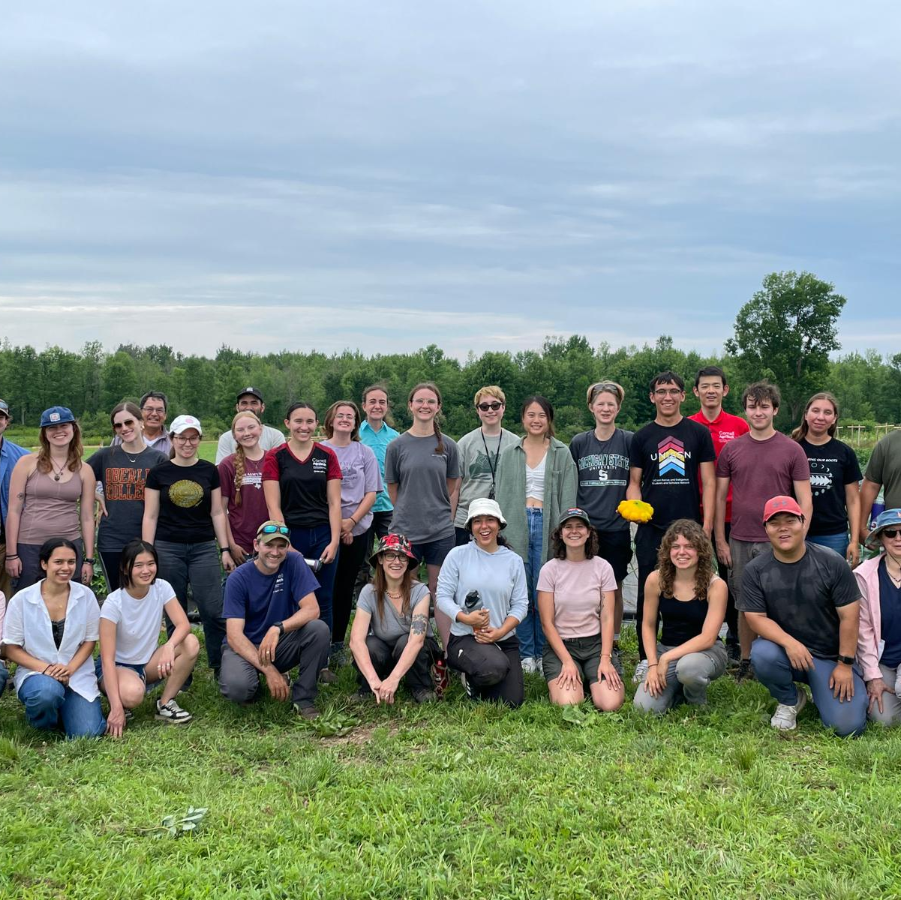
Accomplishments, Impacts & Future Directions
Accomplishments:
3 program years completed
2022 – 8 students (TX, CA, OH, KY, FL, RI, PR)
2023 – 12 students (TX, VA, NC, NY, VT, IN, OK, IA, FL)
2024 – 10 students (TX, MI, NY, JN, OH, PR, MD, DC)
Impacts:
30 students trained in total
Projects from 4 plant science disciplines and agribusiness
Students acquired new knowledge from farm managers, facility operators and extension professionals
Future Directions:
Expanding program and linking with new USDA funding from New Beginnings for Tribal Scholars (NBTS) program

