Slide 1
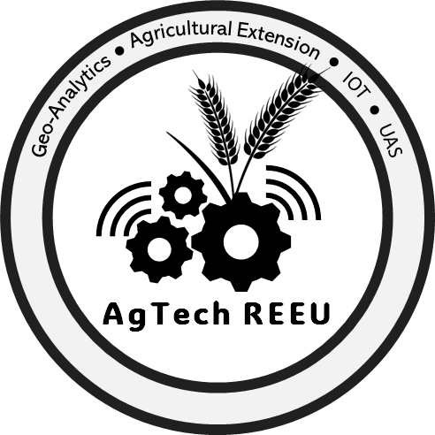
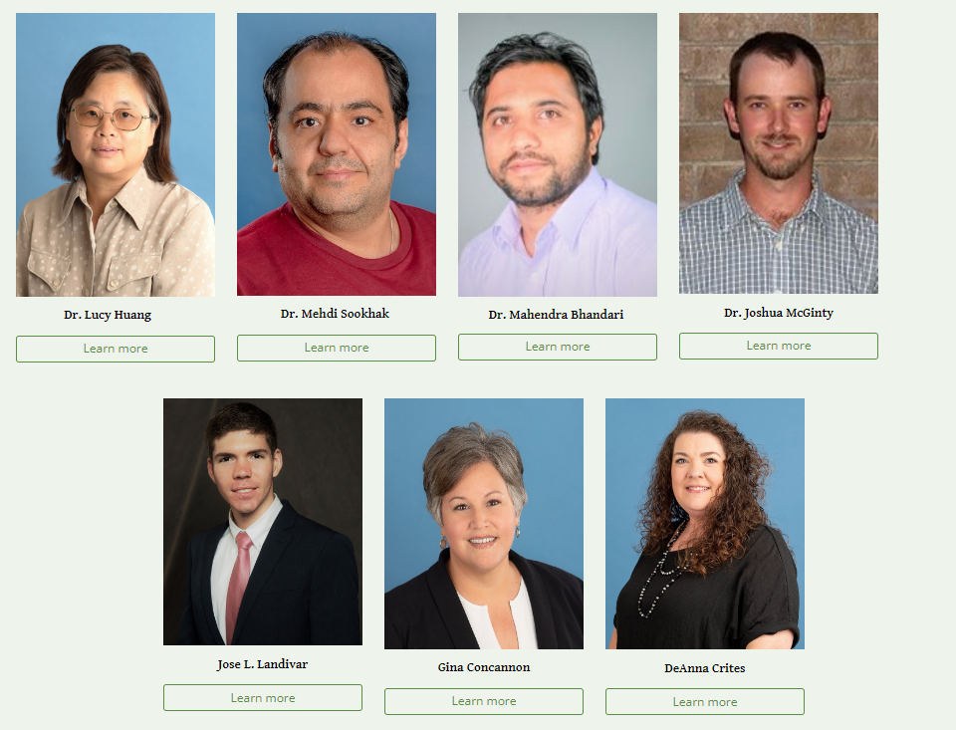
Project Background & Introduction
Developing the Workforce for Next-Generation Agriculture through Research and Extension Experiences for Undergraduates
PD – Institution: Lucy Huang - Texas A&M University – Corpus Christi
USDA NLGCA Award # 2023-67037-40308
A 25-week (Spring, Summer, and Fall) hands-on, team-based, project-focused immersive research and extension experience
Four research projects focused on innovative agricultural technologies (IoT, UAS, and geospatial data analytics) and agricultural extension
A multidisciplinary project leadership and mentoring team
A diverse background of students from STEM, agriculture, or related fields of study
Inspiring curiosity and confidence in STEM students to pursue further education and join the agricultural workforce
Notes:
Title and content

Slide 2
Implementation Challenges & Lessons Learned
Challenges:
Student recruitment: with a primary focus on recruiting from underrepresented groups in Texas
Student engagement: students were from diverse backgrounds (agriculture, STEM)
Summer activities and logistics: coordinating summer activities and managing logistics within a limited budget
Lessons Learned:
Student engagement: balance between hands-on training and team-based research project
Teamwork skills: building strong teamwork and communication skills is critical for achieving project goals

Slide 3
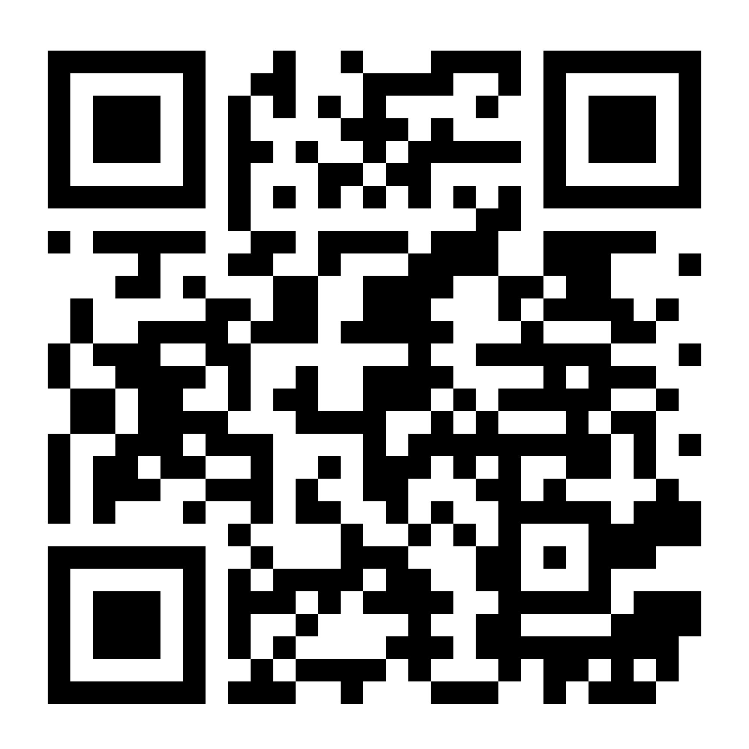
Accomplishments, Impacts & Future Directions
Accomplishments:
Established effective processes and structures to manage program activities, including research, recruitment, and mentoring
Offered a series of webinars (Spring 2024) alongside hands-on training, team-based research projects, and field trips (Summer 2024)
Recruited 8 students (3 in Ag, 4 in CS, 1 in GIS), 7 from underrepresented groups, who successfully completed Spring and Summer activities
Impacts:
Increased student confidence as they continue research in digital agriculture
Strengthened connections with local county extension agents and agricultural producers
Raised awareness of innovative agricultural technologies in local communities
Future Directions:
Ongoing recruitment efforts for 8 students in Cohort 2
Increasing partner and mentor engagement and participation in summer research projects
Continuous improvement of student support strategies
link
This work is supported by the ARFI Education and Workforce Development Program, Grant no: 2023-67037-40308, from the U.S. Department of Agriculture, National Institute of Food and Agriculture. Any opinions, findings, conclusions, or recommendations expressed in this publication are those of the author(s) and should not be construed to represent any official USDA or U.S. Government determination or policy.

