Slide 1
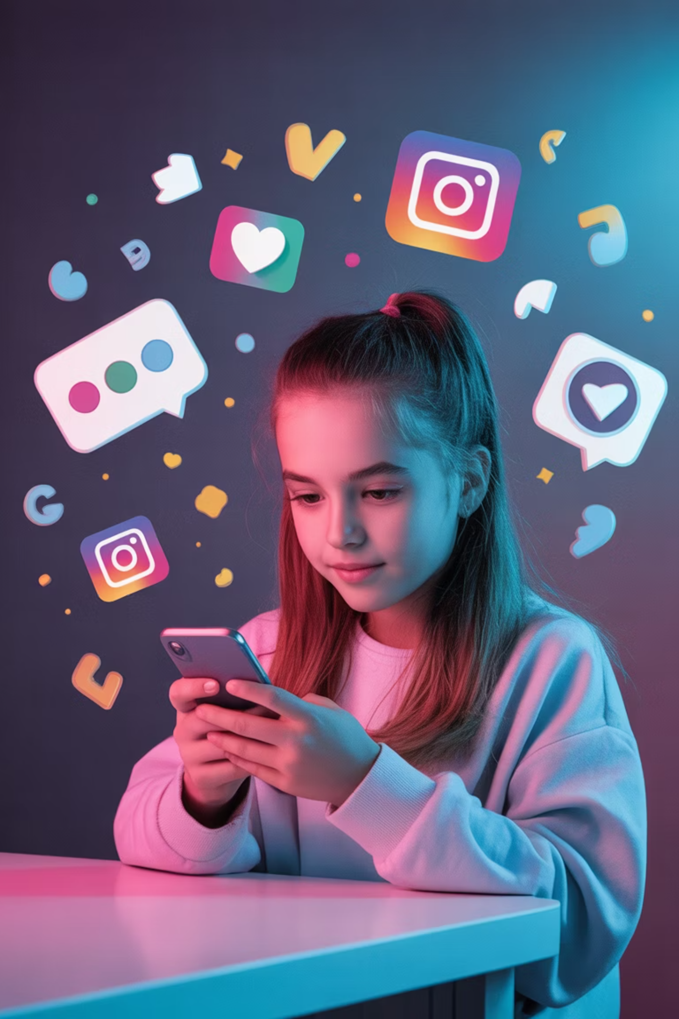
Social Media & Mental Health in Diverse Adolescents
Analyzing the bidirectional relationship between mental health and social media
Sagar Patel · Texas A&M University · sagar25@tamu.edu
PROJECT SMART
ADOLESCENT HEALTH
UNDERGRADUATE RESEARCH

Slide 2
OVERVIEW
Research at a Glance
01
02
03
Introduction
Background
Methods
Science Influencers program & Project SMART
Adolescent development & digital behaviors
Quantitative analysis of social media data
04
05
Findings
Summary
Passive scrolling vs. active engagement
Implications for public health & policy

Slide 3

INTRODUCTION
Bridging Science & Communication
Through the USDA-funded Science Influencers program, Texas A&M undergraduates integrated communication with science. In the last 8 months, I have been working with Dr. Jun Wang and Project SMART, a research initiative focused on technology and behavioral health.
My project—"Data-Driven Insights on Social Media and Mental Health in Diverse Adolescents"—examined how digital behaviors influence psychological well-being, bridging complex health data and public understanding.

Slide 4

BACKGROUND
Why This Research Matters
A Critical Window
Adolescence is a critical period for neurobiological development, and social media has introduced new variables into youth mental health.
Project SMART examines digital behaviors through a data-driven lens, identifying how online interactions correlate with psychological well-being in diverse populations.
As a "Science Influencer," I translated complex health insights into narratives for adolescents, parents, and educators.

Slide 5

METHODS
Research Methodology
Data Cleaning
Quantitative Analysis
Prepare and harmonize variables, remove inconsistencies.
Assess correlations between screen time and mental health.
Data Collection
Science Communication
Collect data from participants including children and their parents
Frame findings for non-academic audiences using storytelling.

Slide 6

METHODS
What We Measured
Word Count
Mental Health Markers
Frequency of negative words being used in children interviews
Self-reported anxiety, depression, and loneliness indicators
Diverse Populations
Communication
Focused analysis on marginalized and diverse adolescent groups
Framing and storytelling to disseminate findings to non-academic stakeholders

Slide 7
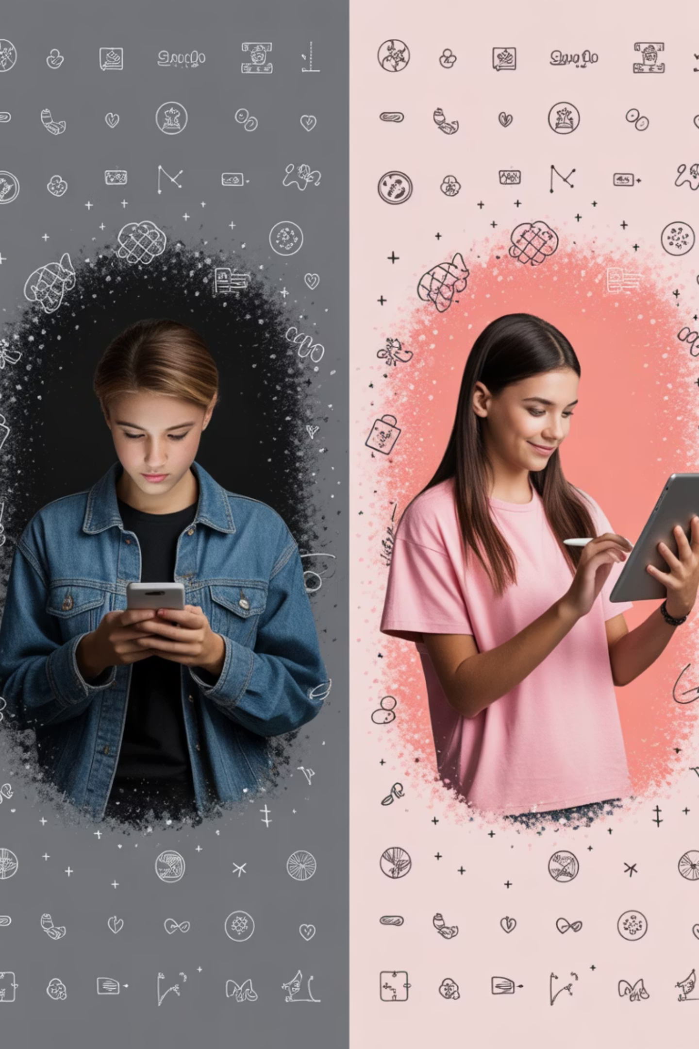
KEY FINDINGS
It's Not How Much — It's How
Passive Scrolling
High-frequency social comparison linked to negative mental health outcomes
Active Engagement
Creative digital participation showed less harmful associations with well-being

Slide 8
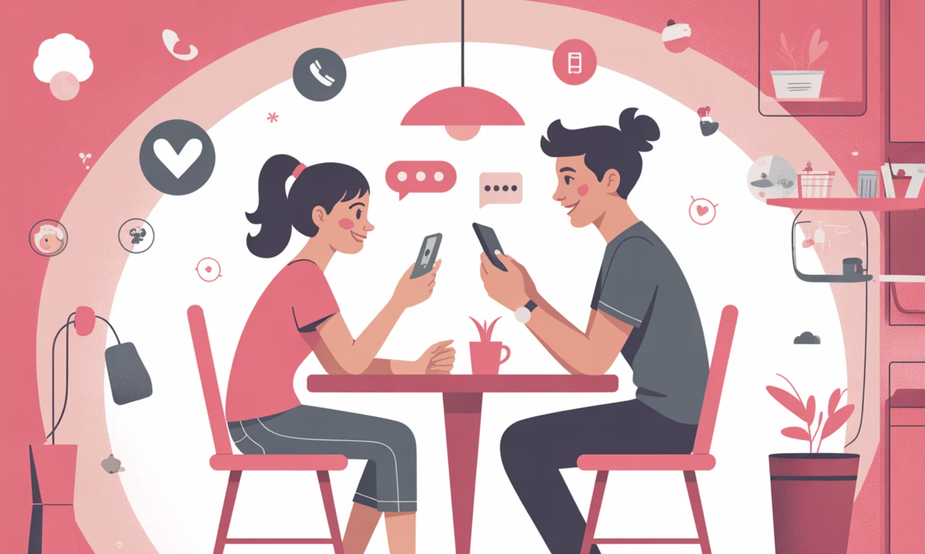

KEY FINDINGS
Protective Factors for Diverse Youth
Critical Interventions Needed
The data underscored digital literacy and parental mediation as protective factors—especially for marginalized and diverse youth.
These findings highlight a critical need for targeted educational interventions that go beyond simple screen-time limits.
The quality and nature of digital interaction matters more than time spent online.

Slide 9

SUMMARY
Professional Growth & Impact
Science Communication
Sophisticated Analysis
Synthesized data into meaningful public narratives
Basic Data Entry
Advanced to complex quantitative methods
Started with foundational research skills
This REEU experience was instrumental in my development as both a researcher and communicator—skills directly applicable to my future career in public health and behavioral science.

Slide 10
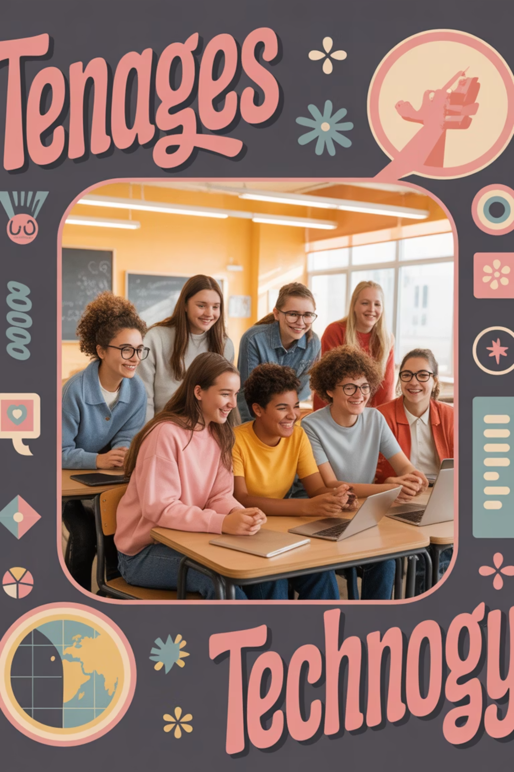
Fostering a Safer Digital Generation
By sharing these findings at the Annual Research Symposium, I aim to advocate for safer digital environments and continue bridging the gap between research and real-world impact.
SAGAR25@TAMU.EDU
TEXAS A&M UNIVERSITY
PROJECT SMART

